Slide 1
Visual Studio and Xamarin Mobile Solution
Nish Anil
Developer Evangelist, Xamarin
@nishanil

Slide 2
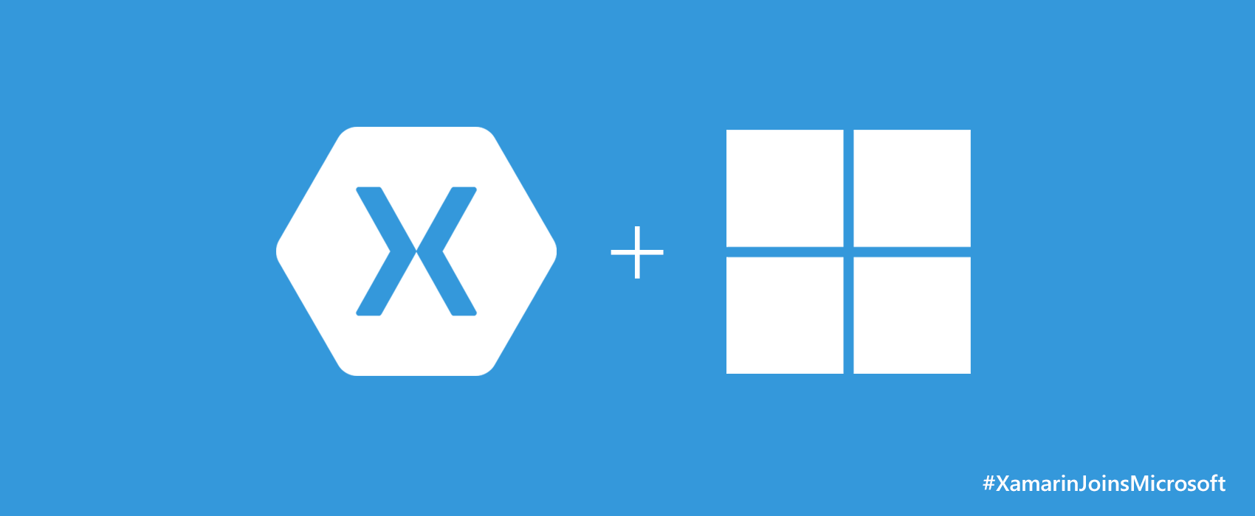

Slide 3





Xamarin – Your Complete Mobile Solution
Develop
Test
Build
Distribute
Monitor
Notes:
Xamarin is your complete mobile solution.
Xamarin Platform is usually what you hear about which is building native iOS, Android, Mac, and Windows Apps all in C#
However Xamarin offers a wide range of products for developers to go mobile including Test Cloud, Hockey App, and a way to learn all of mobile with University.

Slide 4
Develop
Notes:
Xamarin is your complete mobile solution.
Xamarin Platform is usually what you hear about which is building native iOS, Android, Mac, and Windows Apps all in C#
However Xamarin offers a wide range of products for developers to go mobile including Test Cloud, Hockey App, and a way to learn all of mobile with University.

Slide 5
What is Native?
Notes:
What makes up a “Native” mobile application? I am sure you have heard the “native” thrown around, but what does that really mean?

Slide 6
Notes:
A native app needs a lot of things, but three important ones stick out:
Native User Interface: Apps need to look and act correct per platform.
Full SDK Access: As a developer we need to add the latest and greatest features
Native Performance: Needs to be fast and fluid

Slide 7
Notes:
Instant Articles was recently released by Facebook for browsing articles on the iPhone and it is a beautiful native experience with great animations taking advantage of the great look of iOS. To prove the point on how important native is read this quote.

Slide 8
Architecting Mobile Apps
Notes:
So we know what we want how do we get there? Let’s talk about the state of mobile development.

Slide 9
Silo Approach
iOS
Android
Windows
Objective-C
Xcode
Java
Android Studio
C#
Visual Studio
No shared code • Many languages & development environments • Multiple teams
Notes:
Multiple Teams
Multiple Code Bases
Expensive & Slow
Positive = Great apps delivered to user’s platform
Negative = Development hampered by multiple code bases & fragmentation

Slide 10
Write Once, Run Anywhere
Lua
Javascript
Actionscript
HTML+CSS
App Generator
Limited native API access • Slow performance • Poor user experience
Notes:
Unhappy Users
Unhappy Developers
Increase in Abandoned Apps
Limited to what is implemented

Slide 11
Xamarin’s Unique Approach
iOS C# UI
Android C# UI
Windows C# UI
Shared C# Mobile
Shared C# codebase • 100% native API access • High performance
Notes:
UI build natively per platform, leveraging C#
C# + XAML
C# + XML
C# + XIB
One shared app logic code base, iOS, Android, Mac, Windows Phone, Windows Store, Windows

Slide 12
Xamarin + Xamarin.Forms
iOS C# UI
Android C# UI
Windows C# UI
Shared UI Code
Shared C# Backend
Shared C# Backend
Traditional Xamarin Approach
With Xamarin.Forms: More code-sharing, all native
Notes:
Xamarin recently introduced Xamarin.Forms a new library for cross platform user interface. We will touch up on this later, but this enables you to be highly productive, share code, but build out UI on each platform and access platform APIs.
With Xamarin.Forms you now have a nice Shared UI Code layer, but still access to platform APIs
You can start from native, pick a few screens, or start with forms, and replace with native later

Slide 13
Xamarin’s Unique Approach
iOS C# UI
Android C# UI
Windows C# UI
Azure
Linux/Mono
CoreCLR
Shared C# Mobile
C# Server
Shared C# Client/Server
Shared C# codebase • 100% native API access • High performance
Notes:
With Xamarin it just isn’t your front end in C# it is your full backend server as well. With Azure or even on Linux running Mono or the CoreCLR your app is fully C# end to end!

Slide 14
Demo
Notes:
Let’s talk a bit about C# and why it is awesome.

Slide 15
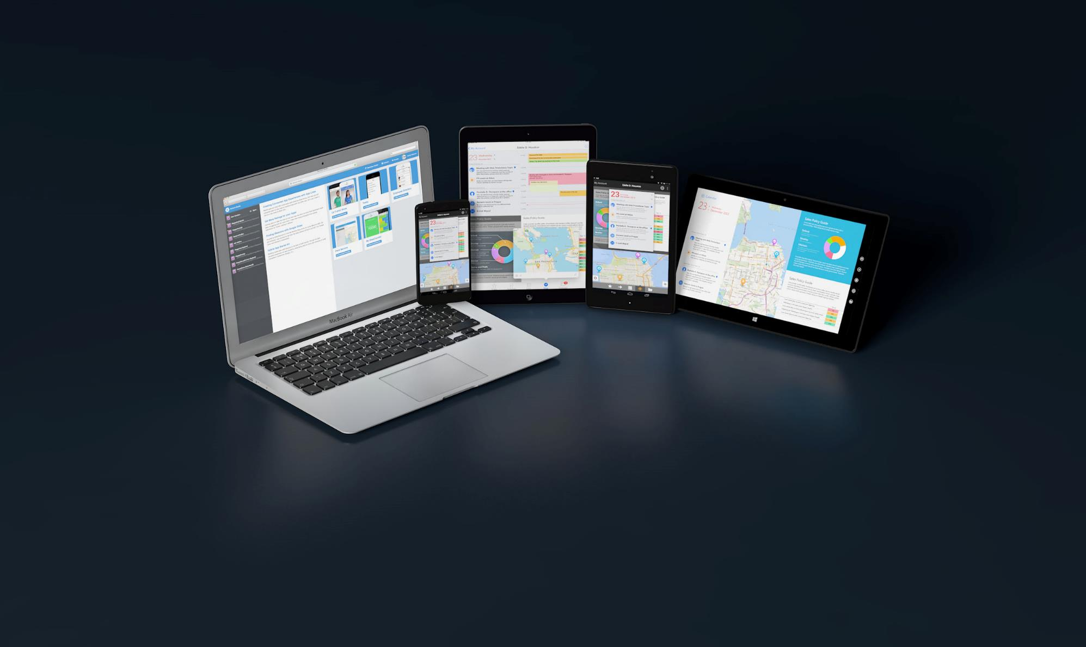
Write Everything in C#
C# Now Runs on 2.6+ Billion Devices

Slide 16
Xamarin is included
in Visual Studio
Notes:
Including the Free Community Edition

Slide 17


Slide 18
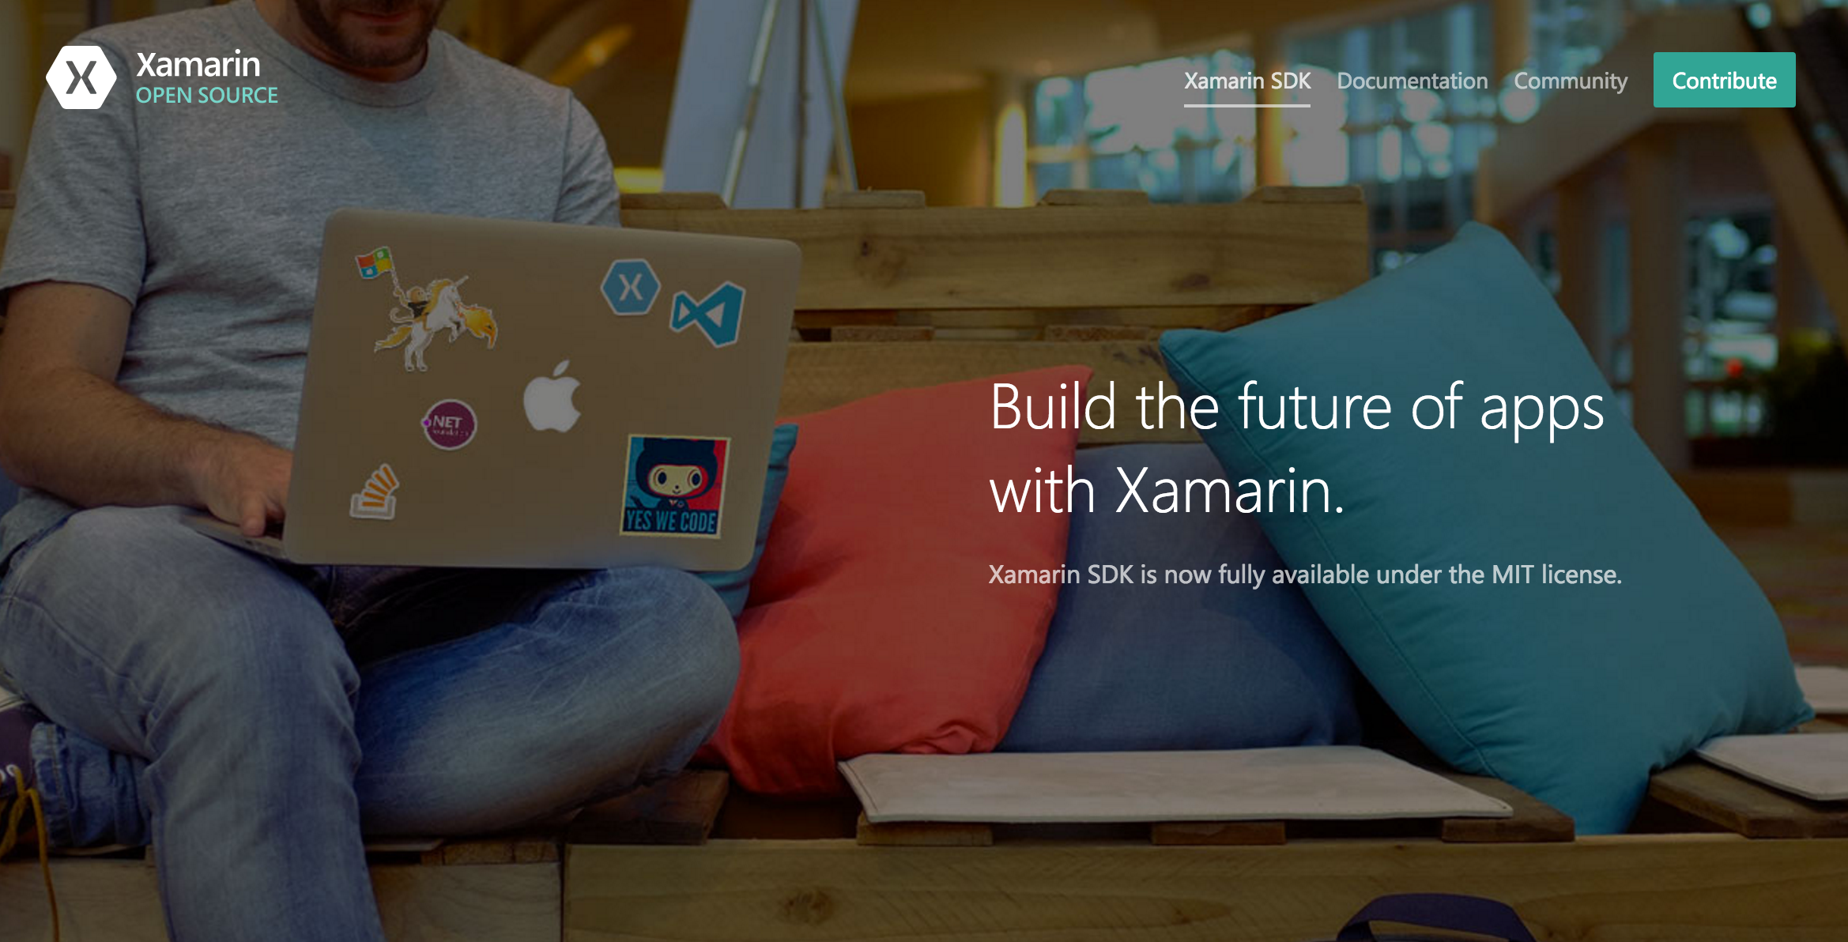
Open Source – open.xamarin.com

Slide 19
How Xamarin Works

Slide 20
Windows APIs
Microsoft.Phone
Microsoft.Networking
Windows.Storage
Windows.Foundation
Microsoft.Devices
System.Net
System
System.IO
System.Linq
System.Xml
System.Data
System.Windows
System.Numerics
System.Core
System.ServiceModel
Notes:
If you have ever developed for a Windows Platform before these .NET namespaces might look familiar.
However, if we go to a new platform such as Windows Phone or Store we have a new SDK to use and a new set of namespaces.

Slide 21
iOS – 100% API Coverage
MapKit
UIKit
iBeacon
CoreGraphics
CoreMotion
System.Net
System
System.IO
System.Linq
System.Xml
System.Data
System.Windows
System.Numerics
System.Core
System.ServiceModel
Notes:
You can think of iOS and Android development the same with Xamarin. You can see we have all of our .NET namespaces and libraries, but Xamarin give us 100% api coverage of each iOS API in it’s SDK that we access view C#.

Slide 22
Android – 100% API Coverage
Text-to-speech
ActionBar
Printing Framework
Renderscript
NFC
System.Net
System
System.IO
System.Linq
System.Xml
System.Data
System.Windows
System.Numerics
System.Core
System.ServiceModel
Notes:
The same is true for Android as well.

Slide 23
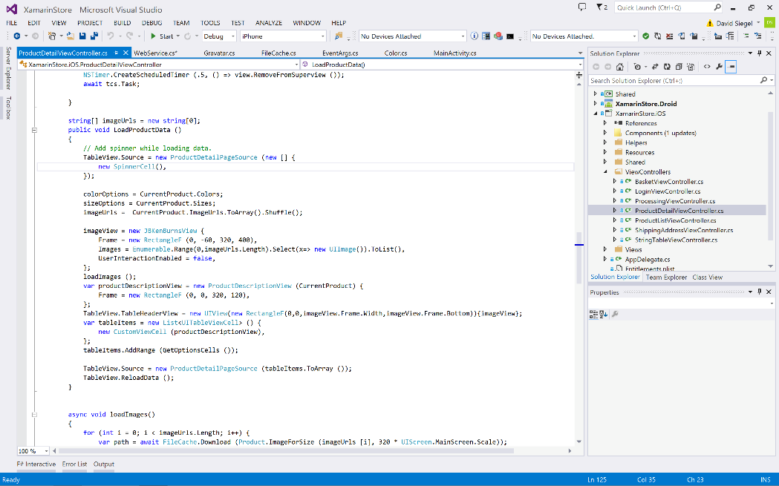
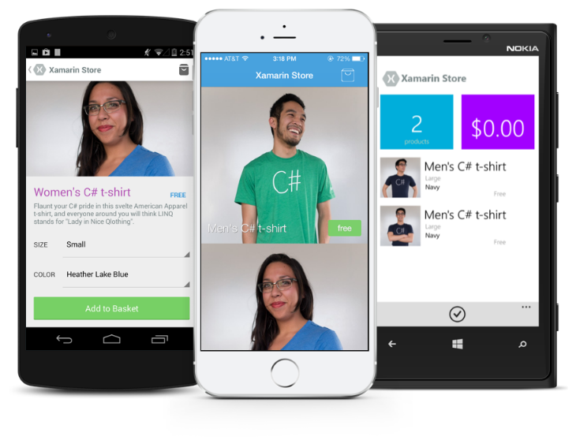
Anything you can do in Objective-C, Swift, or Java can be done in C# and Visual Studio with Xamarin.

Slide 24
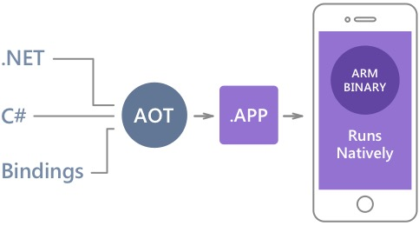
Native Performance
Xamarin.iOS does full Ahead Of Time (AOT) compilation to produce an ARM binary for Apple’s App Store.
Xamarin.Android takes advantage of Just In Time (JIT) compilation on the Android device.
Notes:
There is no compromise on performance.
Xamarin apps look and feel native because they are native.

Slide 25
✓Always Up-to-Date
Same-day support:
iOS 5
iOS 6
iOS 7
iOS 7.1
iOS 8
iOS 9
Full support for:
Apple Watch
Apple TV
Google Glass
Android Wear
Amazon Fire TV
and much more
Notes:
Apple has a developer preview where Xamarin has alphas ready. Google does not offer this.
Android versions are usually 4 to 8 weeks out for a stable release, but alphas and betas are usually earlier.
Xamarin realizes how important having iOS ready because within 24 hours a large portion of iOS users upgrade
Android on the other hand is much different. After 4 months on the market Android 4.4 only had 1% adoption

Slide 26
Sharing Code

Slide 27
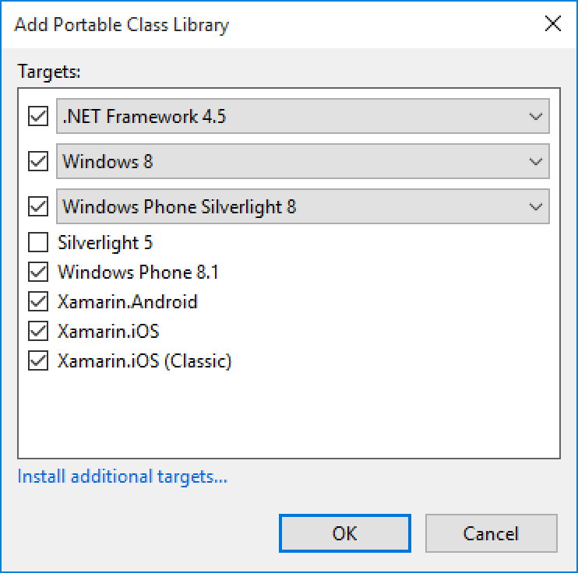
Portable Class Libraries
1 Assembly
Multiple Platforms
Including:
Xamarin.iOS and Xamarin.Android

Slide 28
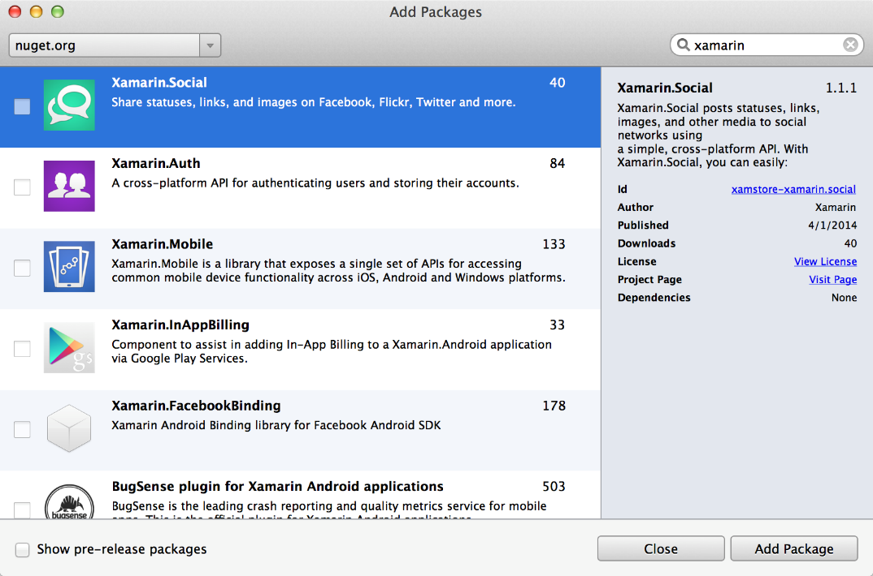
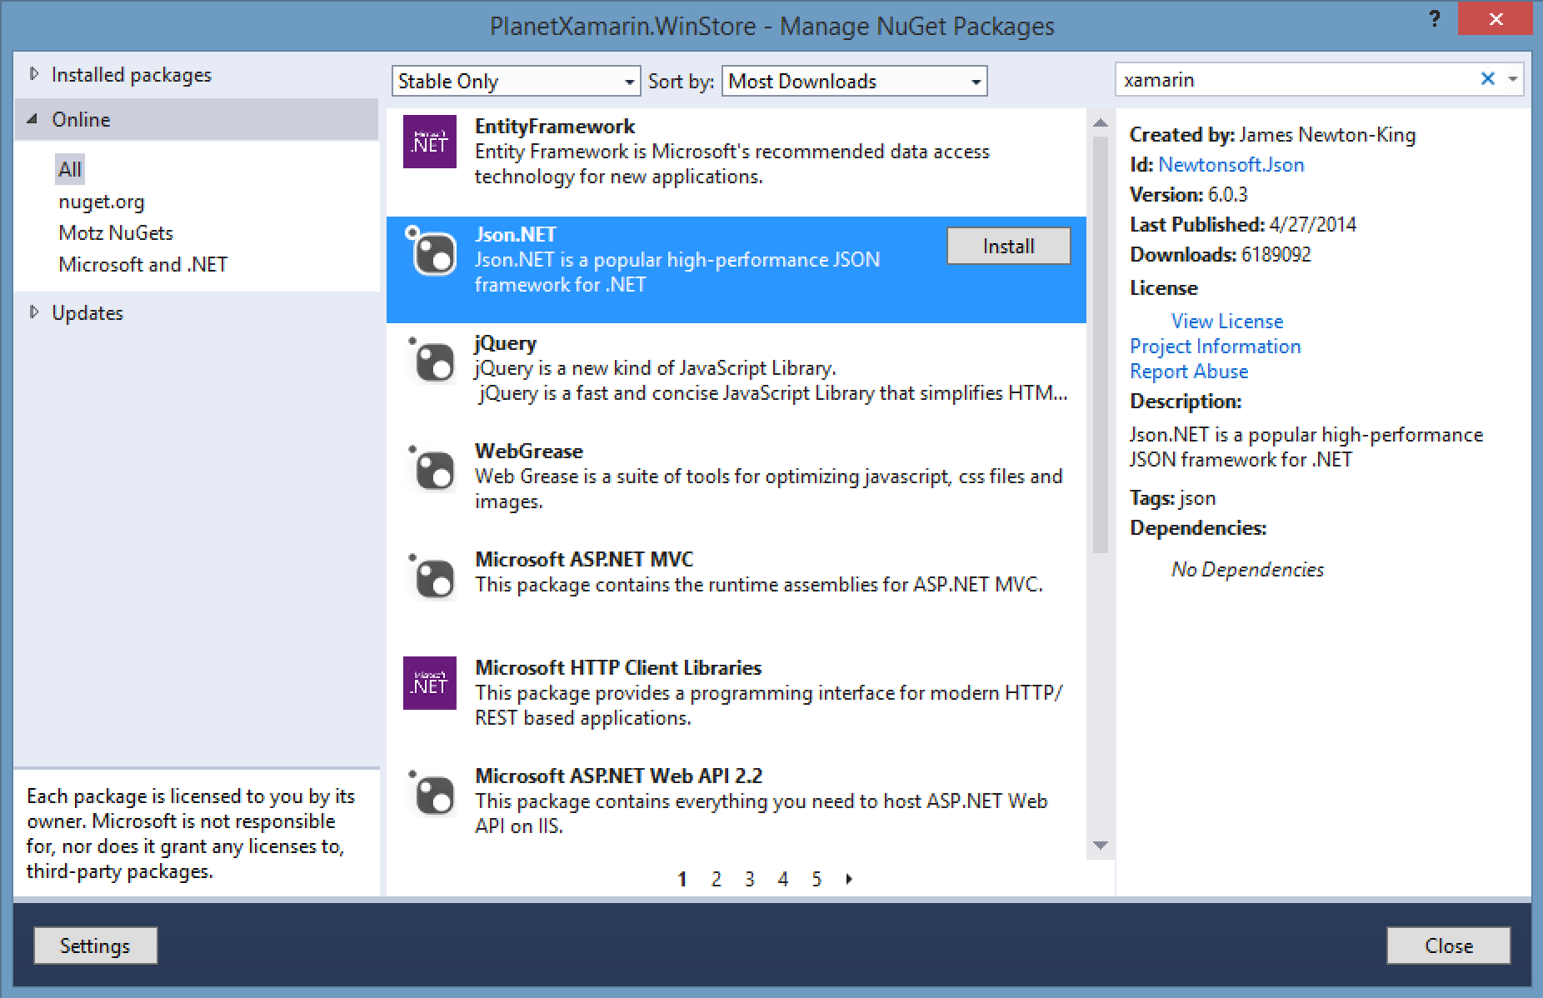
NuGet
Notes:
Use all of your favorite libraries from NuGet or share and distribute your own!

Slide 29
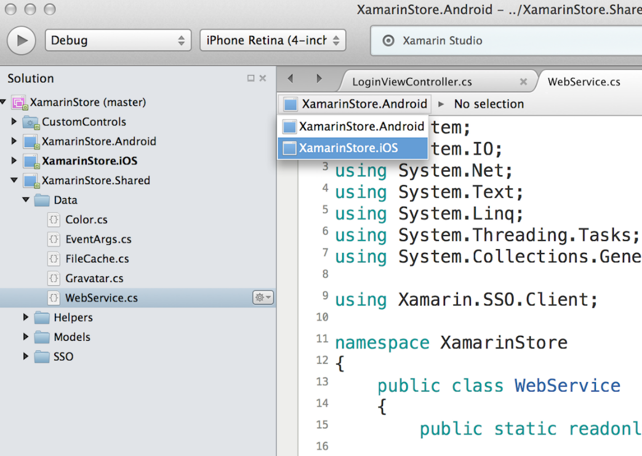
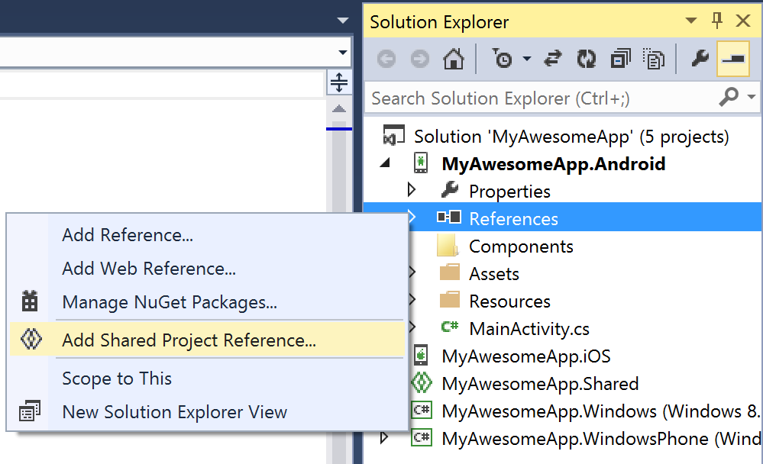
Shared Projects

Slide 30
Code Sharing Stats
iCircuit
Touch Draw
Android
iOS
Mac
Windows Phone
Notes:
iCircuit is made by Frank Krueger, a long time Mono & Xamarin developer.
Sharing code lead to 70 to 90% code reuse across platforms speeding up development
Real-time circuit simulator and editor used to design analog and digital circuits
http://praeclarum.org/post/42378027611/icircuit-code-reuse-part-cinq

Slide 31
Meet Xamarin.Forms
Build native UIs for iOS, Android, and Windows Phone from a single, shared C# codebase.
Notes:
Xamarin Forms is a new set of APIs allowing you to quickly and easily write shared User Interface code that is still rendered natively on each platform, while still providing direct access to the underlying SDKs if you need it.

Slide 32
Xamarin + Xamarin.Forms
iOS C# UI
Android C# UI
Windows C# UI
Shared UI Code
Shared C# Backend
Shared C# Backend
Traditional Xamarin Approach
With Xamarin.Forms: More code-sharing, all native
Notes:
We see here the Xamarin approach we talked about earlier
This enables you to be highly productive, share code, but build out UI on each platform and access platform APIs
With Xamarin.Forms you now have a nice Shared UI Code layer, but still access to platform APIs
You can start from native, pick a few screens, or start with forms, and replace with native later

Slide 33
What’s included
✓ 40+ Pages, layouts, and controls
(Build from code behind or XAML)
✓ Two-way data binding
✓ Navigation
✓ Animation API
✓ Dependency Service
✓ Messaging Center
Shared UI Code
Shared C# Backend
Notes:
Xamarin.Forms is much more that just a framework and includes everything you need to get up and running to build out full native applications.
If you are used to MVVM type of development you will feel right at home.

Slide 34

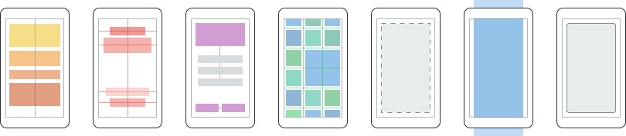
Layouts
Pages
Content
MasterDetail
Navigation
Tabbed
Carousel
Stack
Absolute
Relative
Grid
ContentView
ScrollView
Frame
Notes:
First you have a set of pages for each screen of your application
There are things like Content, and MasterDetail which gives you a nice flyout
With a tabbed view you get the correct look on each platform
iOS on bottom, Android on top, and on WP you have a Pivot control
Inside of a page are layouts
A lot of options from something simple like a stack panel to complex and powerful grids

Slide 35
Controls
ActivityIndicator
BoxView
Button
DatePicker
Editor
Entry
Image
Label
ListView
Map
OpenGLView
Picker
ProgressBar
SearchBar
Slider
Stepper
TableView
TimePicker
WebView
EntryCell
ImageCell
SwitchCell
TextCell
ViewCell
Notes:
You have more than 40 controls, layouts, and pages to mix and match from.
These are all of the controls you have out of the box, you can of course create your own.
What is unique is you get the native control and have access to it.
Consider an Entry Field
On iOS it is mapped to UITextField
Android it is EditText
Windows Phone it is a TextBox

Slide 36
Demo

Slide 37
Development Experience

Slide 38
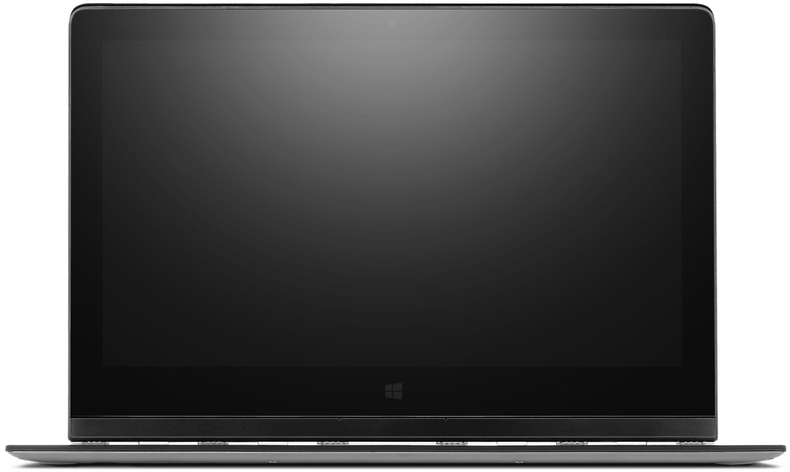
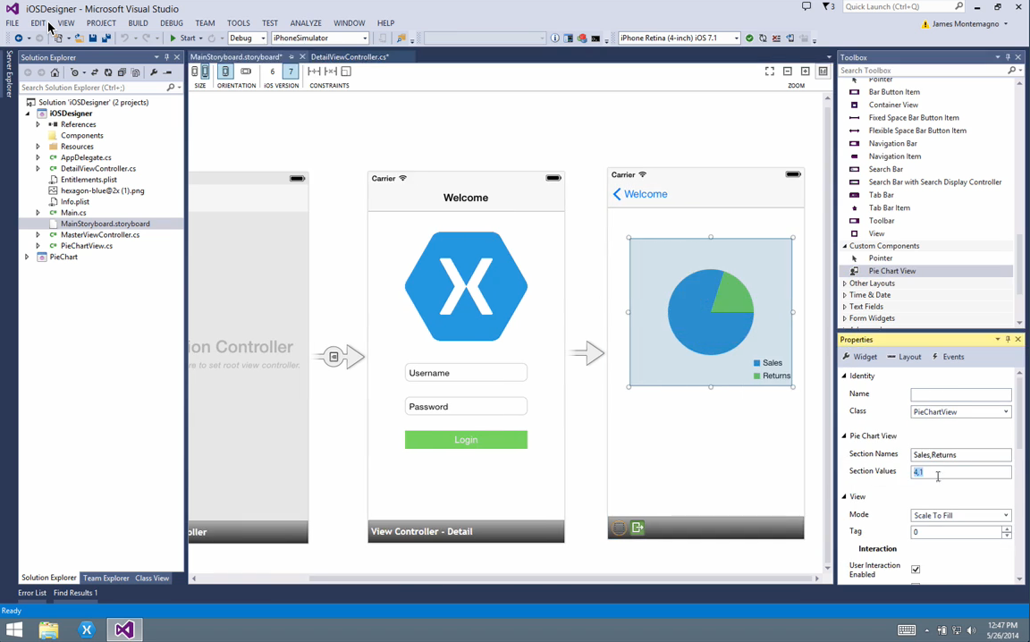
Visual Studio Integration
Notes:
Single Solution for iOS, Android, and Windows
Leverage Entire Microsoft Ecosystem:
ReSharper
Team Foundation Server
Azure
ASP.NET
Favorite Code Coverage and Profiling Tools
Starter Compatible
Visual Studio 2012, 2013, and 2015 including Community Edition

Slide 39
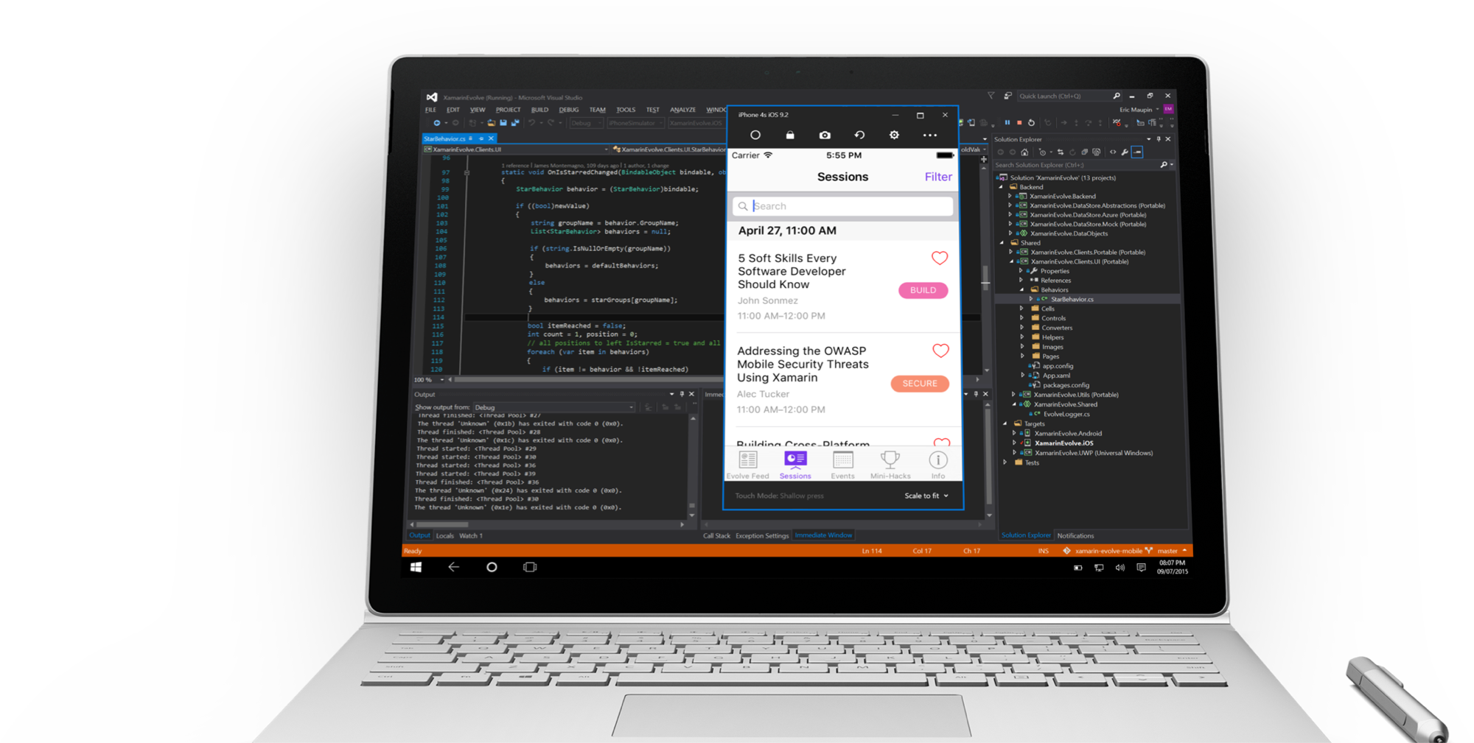
Visual Studio iOS Simulator Remoting
Multi-Touch Enabled
Pressure Sensitive
Super Fast
Rotate, screenshots, location changes
Never leave VS

Slide 40
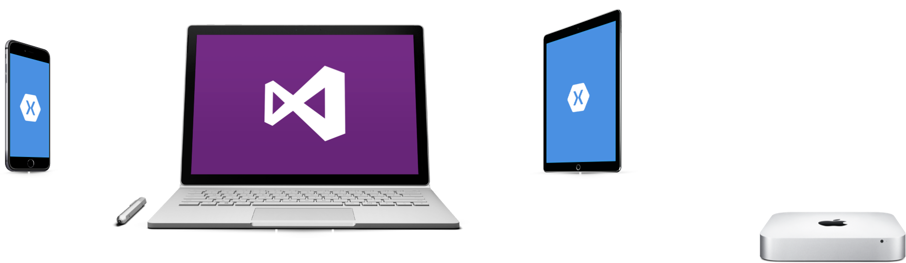
Visual Studio iOS USB Remoting
Notes:
Plug your iOS device into your PC
USB port is automatically remoted to your Mac.
Never leave your PC

Slide 41
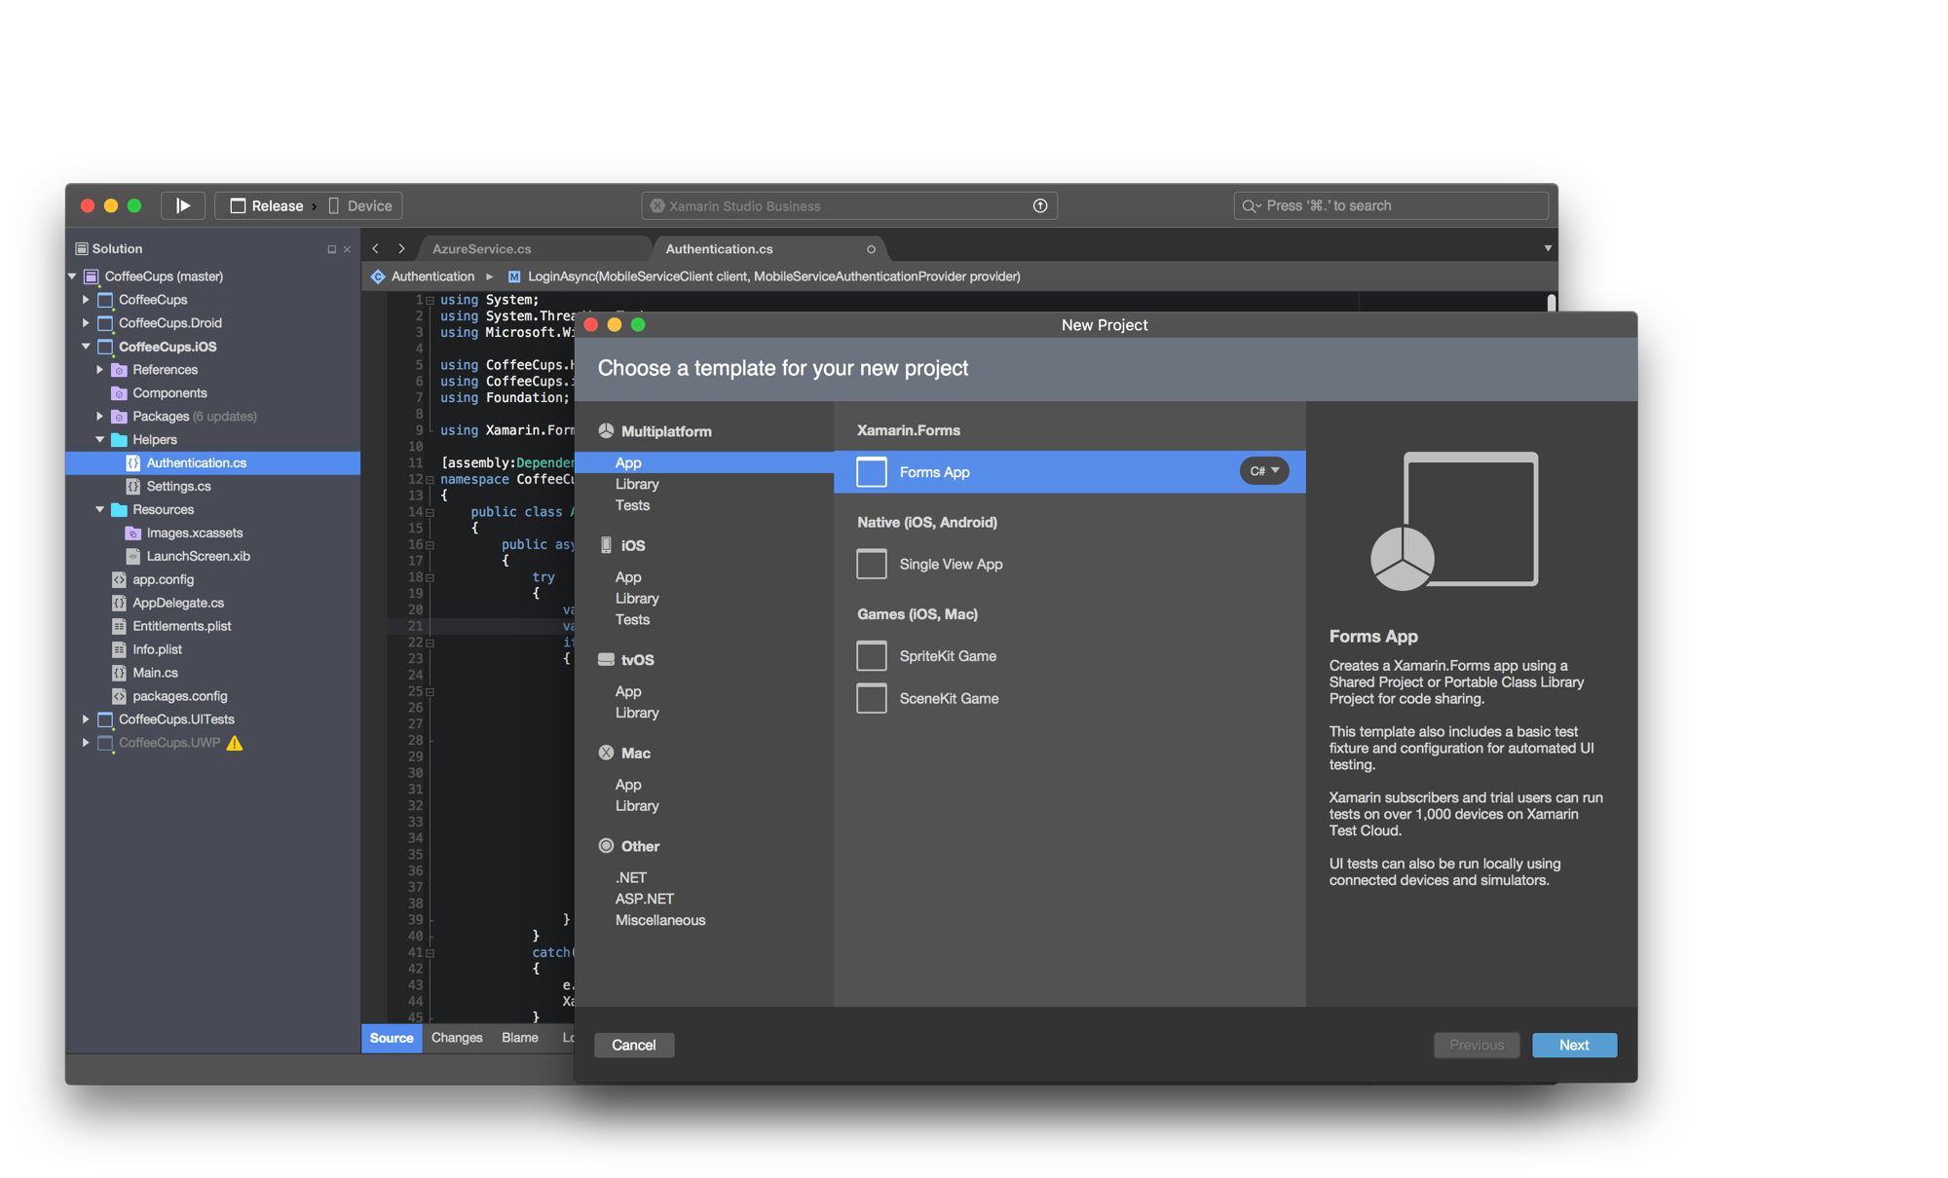
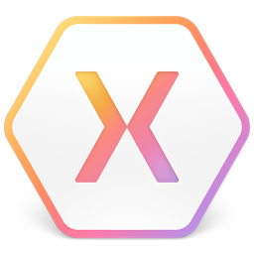
Xamarin Studio – Mac
Notes:
Xamarin Studio on Mac offers: Android, iOS and Mac development
World Class IDE with great features:
Code Analysis
Upload to Test Flight
Git & Subversion Integration
Code Completion
Code Navigation
Easy transition from Visual Studio
The same Solution & Projects open in BOTH Xamarin Studio and Visual Studio!

Slide 42
Test
Notes:
Xamarin is your complete mobile solution.
Xamarin Platform is usually what you hear about which is building native iOS, Android, Mac, and Windows Apps all in C#
However Xamarin offers a wide range of products for developers to go mobile including Test Cloud, Hockey App, and a way to learn all of mobile with University.

Slide 43
Device Fragmentation
App Complexity
Fast Release Cycles
Short Sessions
High Mobile User Expectations
Challenges
Notes:
Well there are several challenges that we must overcome as mobile developers including….

Slide 44
On Mobile, Quality is Hard
5
20
20
35
6
OS versions
Devices
Languages
Locales
Screen sizes
9
19K+
39
57
27
15
6
OS versions
Distinct devices
Languages
Locales
Screen sizes
Manufacturers
Screen configurations
8
Notes:
First let’s take a look at the shear number of configurations there are between iOS and Android. As iOS progresses this number is only set to increase, and on Android it is already a HUGE number of configurations to even think about testing.
iOS: 7, 7.1, 8, 8.1, 8.2

Slide 45
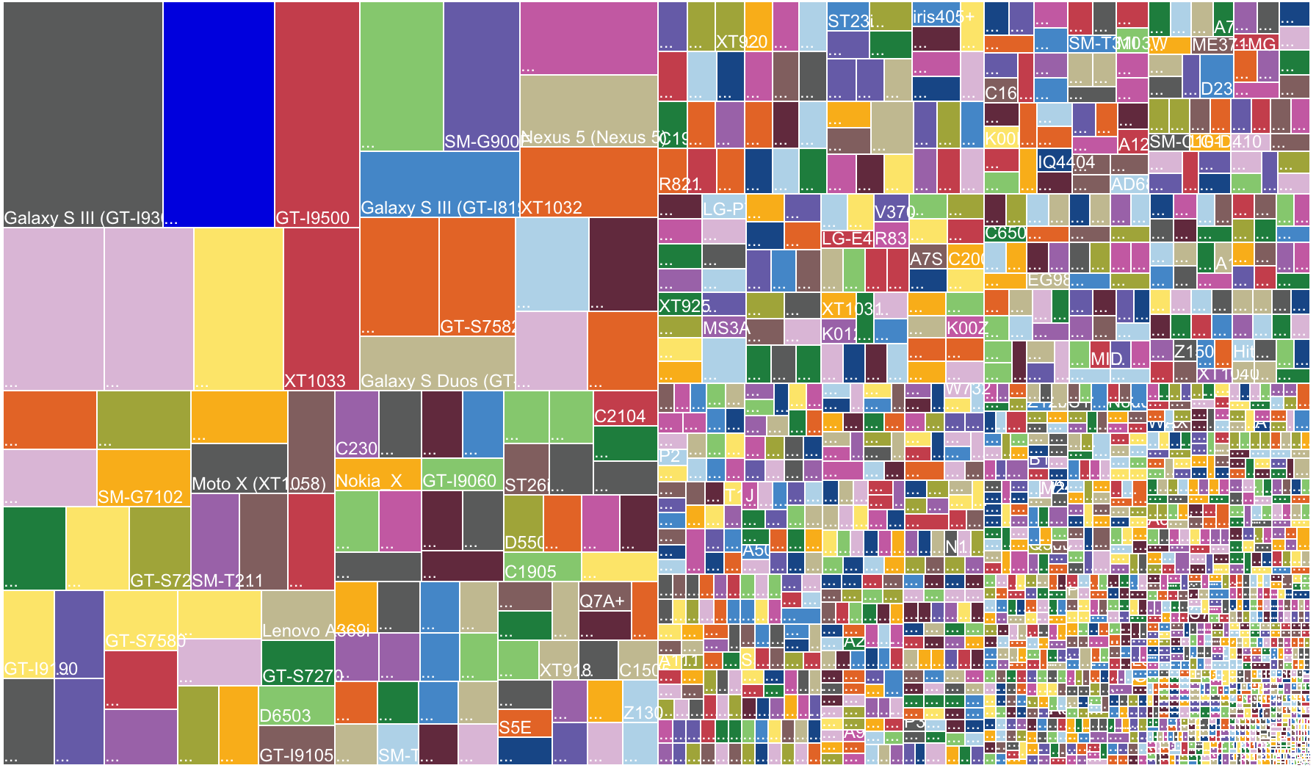
Notes:
OpenSignal is a global app that publishes an annual report on Android device fragmentation based on the distinct Android device types that download their app. This is their August 2014 data, with an astonishing 19,000 device types using their app, up by 60% from just last year.
Different device operating systems, form factors, screen sizes, resolutions, chip sets, and manufacturer modifications make it difficult to know that your app will work well on all devices

Slide 46
Notes:
Looking at just a few of the screen sizes of Samsung devices you couldn’t even fit all of them on the screen, so how do you handle this problem?

Slide 47
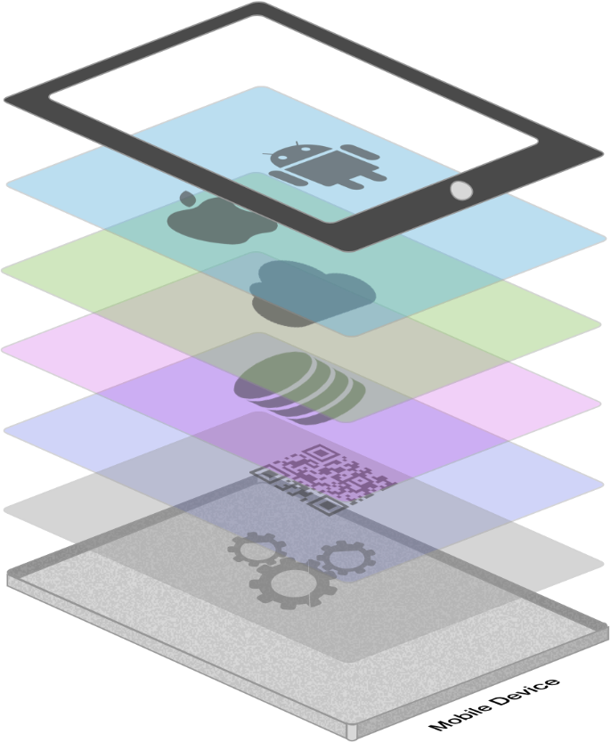







App Complexity
Thousands of iOS and Android APIs
Public web APIs
Backend integrations
Third party libraries
Memory, CPU and network constraints
Notes:
The fragmentation isn’t just in the devices, but as we start to build on our applications you soon found out they are ever increasingly complex.

Slide 48








Tap
Scroll
Swipe
Pinch
Multi Finger
Text Entry
Rotation
GPS
Notes:
With a simple command you can simulate all of your users interactions to build out a great test suite that can be run over and over again.

Slide 49
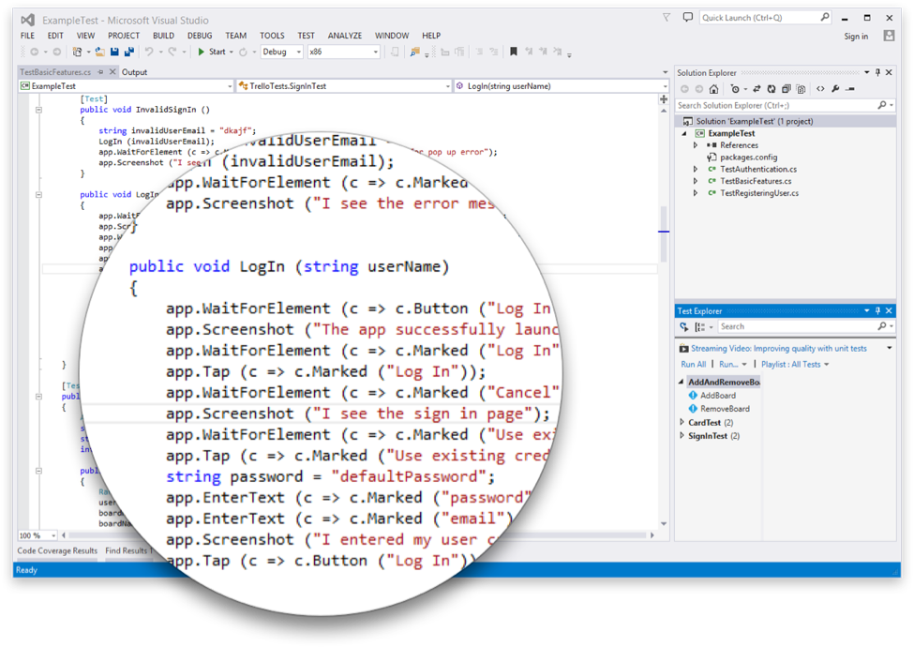
Introducing Xamarin.UITest
Create Automated User Interface tests all in C#
Upload to the Test Cloud or run against a Device or Simulator
Run directly from Visual Studio or Xamarin Studio
Freely available for testing on a Simulator*
Works on ANY app: Native, Hybrid, or Xamarin
Notes:
This is where Xamarin.UITest comes in to help with this shift. Xamarin.UITest is a framework that ties in directly to the Nunit testing framework to write the UI tests. You can even run them directly against a simulator for free to do regression tests on your applications.
Freely available for testing on a Simulator*

Slide 50
Test Recorder for Visual Studio
Record UITests from Visual Studio
Replay or ship to Test Cloud
Use Touch Screen on Android Emulator

Slide 51
Test Recorder for Mac
Record UITests for iOS and Android apps
Replay or ship to Test Cloud

Slide 52

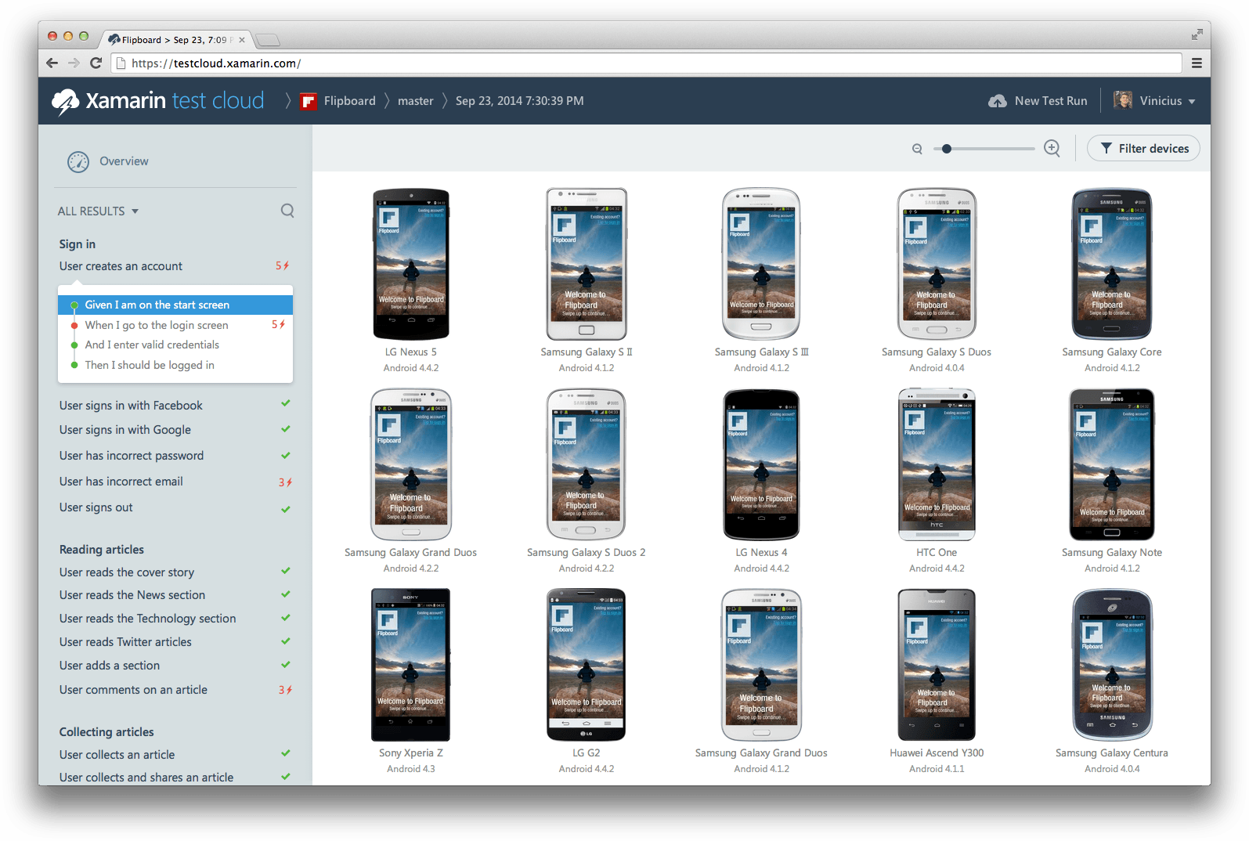
xamarin.com/testcloud
Notes:
Take test scripts and test again thousands of physical devices!
All Xamarin subscribers get free device time! Check store.xamarin.com for details.

Slide 53
Build
Notes:
Xamarin is your complete mobile solution.
Xamarin Platform is usually what you hear about which is building native iOS, Android, Mac, and Windows Apps all in C#
However Xamarin offers a wide range of products for developers to go mobile including Test Cloud, Hockey App, and a way to learn all of mobile with University.

Slide 54
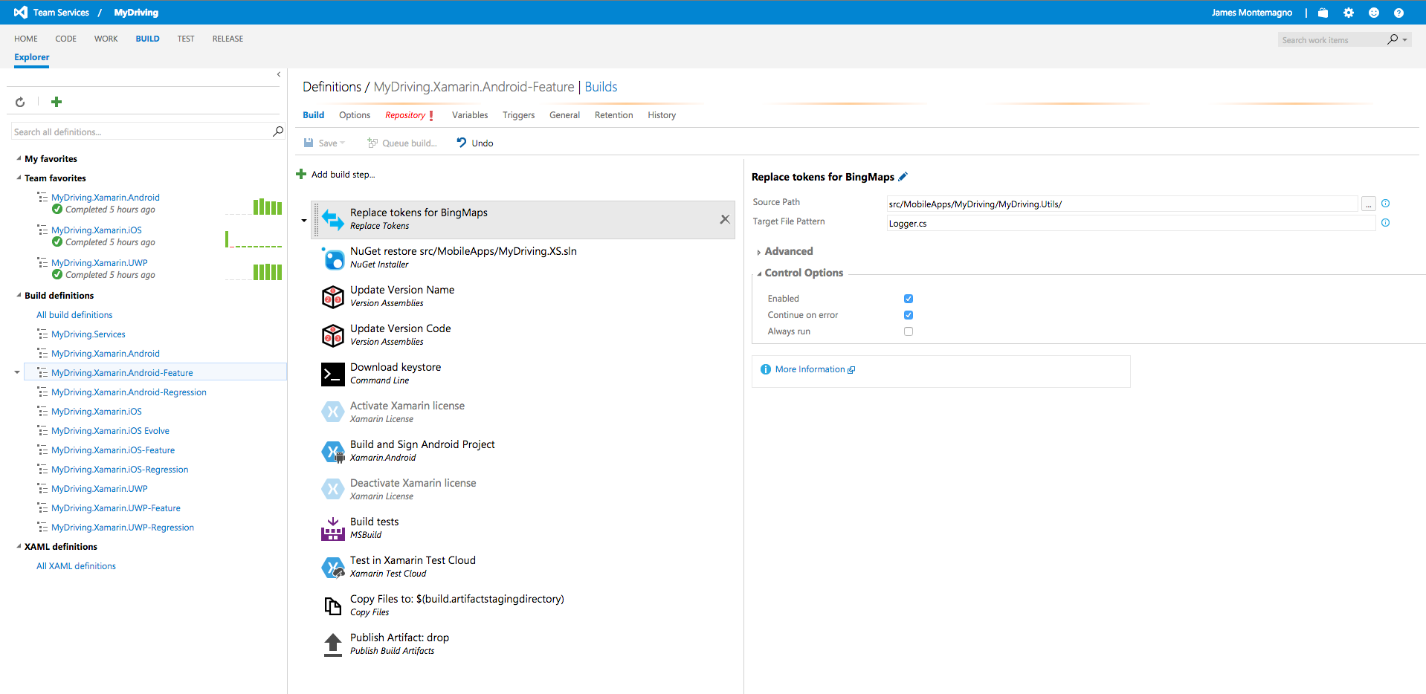
Visual Studio Team Services - Build

Slide 55
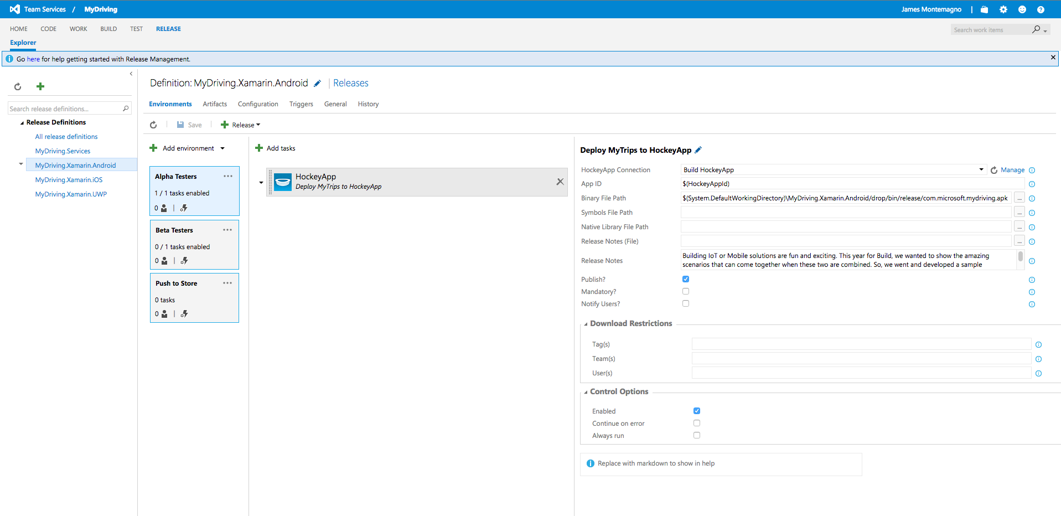
Visual Studio Team Services - Release

Slide 56
Distribute & Monitor
Notes:
Xamarin is your complete mobile solution.
Xamarin Platform is usually what you hear about which is building native iOS, Android, Mac, and Windows Apps all in C#
However Xamarin offers a wide range of products for developers to go mobile including Test Cloud, Hockey App, and a way to learn all of mobile with University.

Slide 57
HockeyApp

Slide 58
Xamarin – Your Complete Mobile Solution
Develop
Test
Build
Distribute
Monitor
Notes:
Xamarin is your complete mobile solution.
Xamarin Platform is usually what you hear about which is building native iOS, Android, Mac, and Windows Apps all in C#
However Xamarin offers a wide range of products for developers to go mobile including Test Cloud, Hockey App, and a way to learn all of mobile with University.

Slide 59
Get Started Today
xamarin.com
Notes:
Get started today with free 30 day trial of Xamarin at xamarin.com

Slide 60
Unrivaled Mobile Development Training
Live unlimited mobile development training from mobile experts, in your time-zone, on your schedule, and as often as you'd like.
Free 30 Day Trial - xamarin.com/university

Slide 61
Thank You! Questions?
Nish Anil
Developer Evangelist
Xamarin
nish@Xamarin.com
nnish.com
@nishanil

